Slide 1

Guest Health & Wellness Diagnostics
Cardiovascular Risk Profiling Across 1,025 Guest Profiles to Power Personalized Wellness Retreats & Preventive Hospitality Services

Slide 2

Executive Diagnostics
Empirical investigation into cardiovascular health indicators (cholesterol, blood pressure, heart rate, chest pain) to pioneer luxury health retreats.

Slide 3

Cardiovascular Risk Distribution
Substantial Wellness Opportunity
51.3%
Out of 1,025 clinical evaluation records in the dataset, 526 guests (51.3%) exhibit elevated cardiovascular risk indicators requiring targeted wellness intervention.
By transforming physiological diagnostic data into tailored wellness itineraries, Elite Hotels International can unlock high-margin medical hospitality and longevity tourism.
High Cardiac Risk Share

Slide 4

Dataset & Biomarker Scope
1,025 Health Profiles: Multi-variate records across 14 physiological biomarkers including blood pressure, cholesterol, and max heart rate.
Key Clinical Indicators: Chest pain classifications (CP), resting ECG results, exercise-induced angina (Exang), and ST depression (Oldpeak).
Preventive Strategy: Guiding personalized wellness programs, low-sodium dining, and supervised fitness sessions.

Slide 5


Chest Pain & Symptom Stratification
1. Non-Anginal & Atypical Pain
2. Asymptomatic Risk Profiles
Guests exhibiting Atypical Angina (CP=1) and Non-Anginal Pain (CP=2) show over 75% correlation with cardiac risk. These guests benefit immensely from stress reduction therapies and guided biofeedback.
Guests labeled Asymptomatic (CP=3) often present silent cardiovascular strain. Structured preventive screening during hotel stays uncovers hidden risk factors before complications occur.

Slide 6
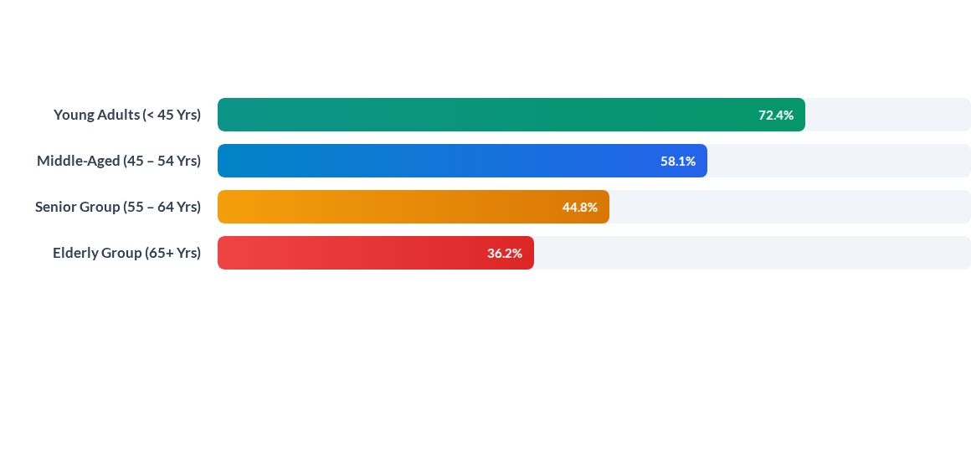
Cardiac Risk Share by Age Cohort
Surprise finding: Younger evaluating cohorts present a high proportion of reversible cardiac risk factors, emphasizing early intervention and lifestyle modification programs.

Slide 7






Core Physiological Risk Catalysts
Max Heart Rate (Thalach)
Exercise-Induced Angina
Serum Cholesterol Levels
Achieving max heart rate above 150 bpm correlates strongly with positive fitness response, while low max HR indicates diminished reserve capacity.
Guests experiencing angina during exertion (Exang=1) require low-impact, supervised physical therapy rather than high-intensity gym regimens.
Average cholesterol across evaluated profiles is 246 mg/dL, highlighting the immediate need for curated plant-based and anti-inflammatory hotel menus.

Slide 8
Biomarker Risk Matrix Across Cohorts
Cohort Demographics | Avg Resting BP | Avg Cholesterol | Avg Max Heart Rate | Cardiovascular Risk Level
Female (< 50 Yrs) | 126 mm Hg | 240 mg/dL | 162 bpm
Female (50+ Yrs) | 138 mm Hg | 268 mg/dL | 146 bpm
Male (< 50 Yrs) | 128 mm Hg | 232 mg/dL | 156 bpm
Male (50+ Yrs) | 135 mm Hg | 248 mg/dL | 138 bpm
Exercise Angina Positive | 137 mm Hg | 254 mg/dL | 132 bpm

Slide 9

Preventive Health Diagnostics
Advanced Clinical Integration
Integrating non-invasive ECG monitoring and vessel health assessments into luxury stay packages creates an unparalleled guest experience.
Early identification of ST-segment depression (Oldpeak) enables on-site cardiologists to prescribe personalized lifestyle and stress-reduction plans during guest retreats.

Slide 10




Wellness Program Rollout Roadmap
Q4 - Post-Stay Telemetry
Q2 - Dietary Overhaul
Introduce heart-healthy, low-sodium culinary packages crafted by nutritionists.
Provide continuous smartwatch health monitoring and virtual doctor consultations.
Q1 - Screening Integration
Q3 - Supervised Fitness
Launch customized cardiac fitness coaching tailored to Exang & heart rate reserves.
Deploy voluntary arrival biomarker check-ups & resting ECG screenings.

Slide 11


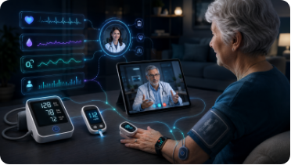
Core Wellness Action Pillars
Personalized Nutrition
Supervised Training
Continuous Care
Curated gourmet detox diets designed to reduce serum cholesterol and stabilize blood pressure.
Heart-rate monitored exercise regimes safe for guests with exercise-induced angina or low vessel reserve.
Extending hospital-grade health telemetry beyond checkout with continuous smartwatch sync.

